Slide 1
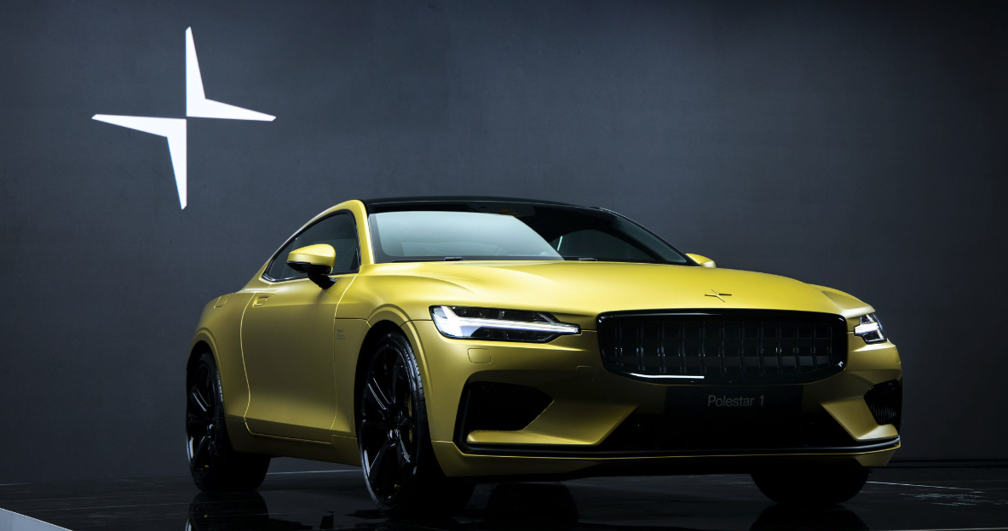
Predicting Polestar Success
Using data analysis of TESLA stock
to determine Polestar success
Notes:
We represent Polestar, an up-and-coming electric vehicle that went public in June 2022.

Slide 2










Overview
Purpose of Project:
Determine whether stock performance of electric vehicles can predict stock performance of Polestar.
Questions to Answer:
Can historical stock prices from other electrical vehicles predict growth of Polestar?
How well suited are we to be competitive in the market?
Faraday Future
Team:
Tracey Fitzpatrick
Cheryl Farnsworth
Kelly Nichols
Holly Smith
Notes:
Our team wondered whether historical stock prices from other electric vehicles (EV) could predict growth of this recent addition to the market.

Slide 3

Faraday Future
Notes:
THROWAWAY SLIDE

Slide 4
Data
Datasets
StockAnalysis.com for a list of IPOS launched in the last recession 2008.
Kaggle for a list of US Company information on these IPOS.
API of historical pricing data to train our model for future price predictions using volume as a predictor.
Outputs

Slide 5
Technologies Used
Tableau
pandas
Notes:
https://cleantechnica.com/2022/07/17/polestar-3-pricing-revealed-are-you-sitting-down/ : “Polestar, the all-electric brand from Volvo Cars [starts at $47,200] is taking direct aim at the Porsche Cayenne [starts at $150,000] in its bid to become a major manufacturer of electric automobiles.”

Slide 6
Data Exploration
These are stand-in pictures.
Must be updated.
Notes:
Can I use what’s in the README?

Slide 7
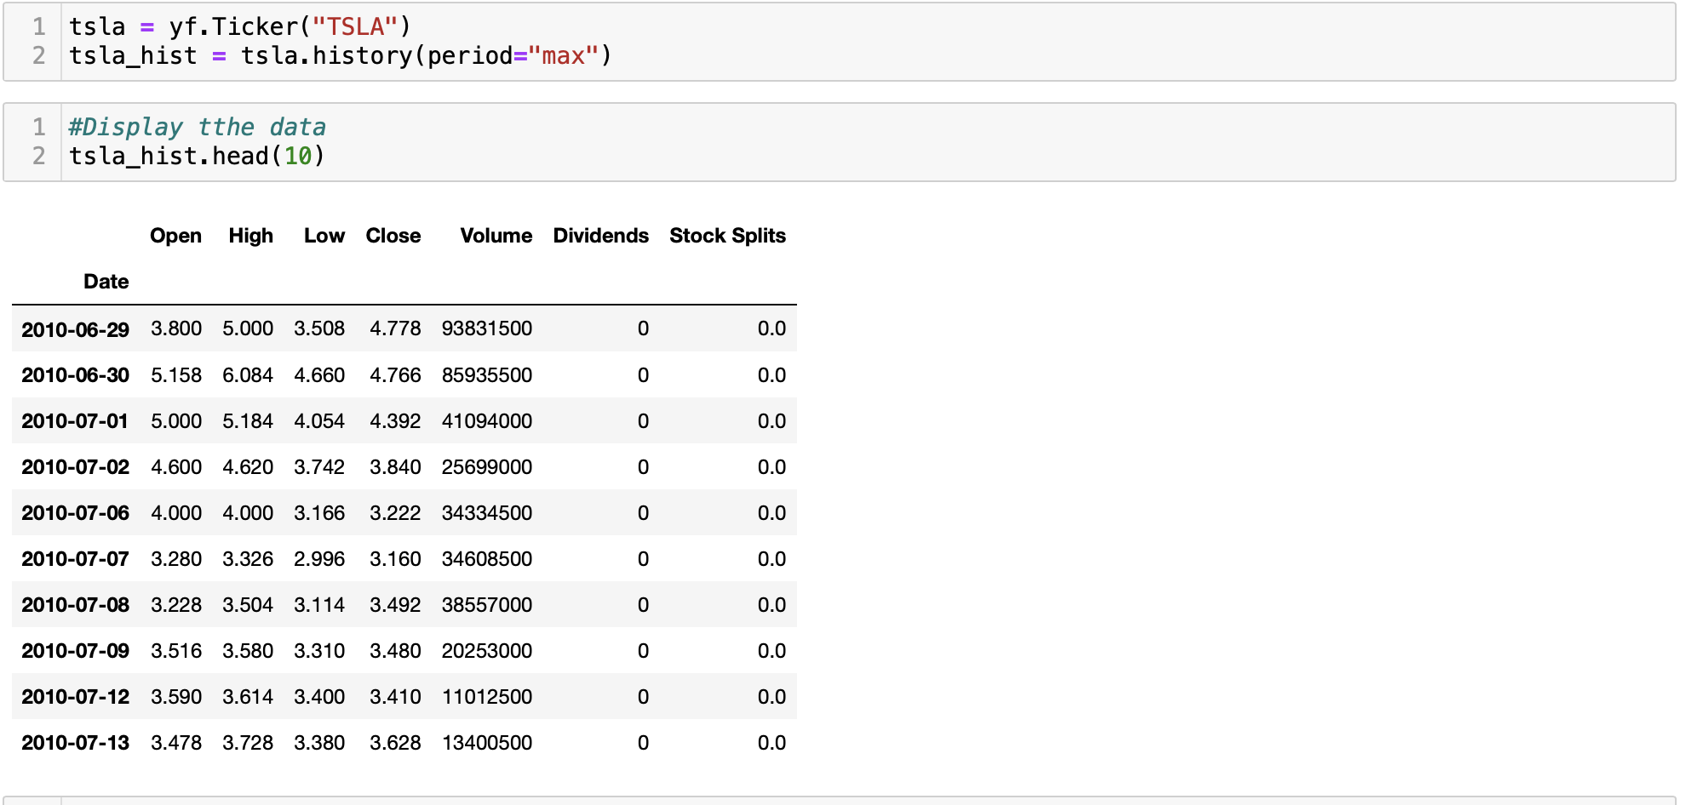
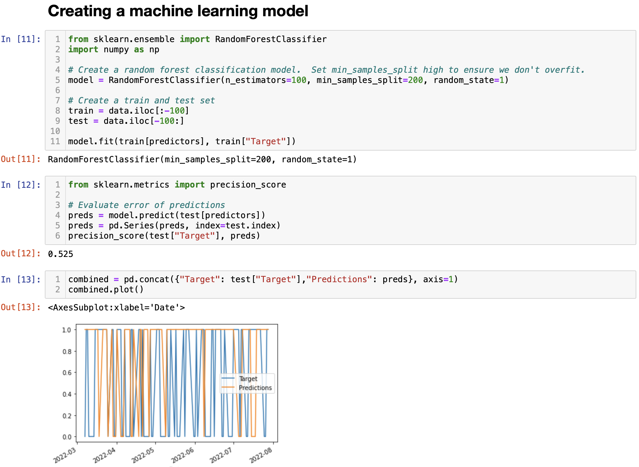
Model Analysis
Our model uses historical pricing and trading volume to predict future share prices for the top 10 electric vehicle companies and potential growth for Polestar.
Step 1 Pull pricing from Yahoo Finance API
Step 2 Predict future pricing for each EV stock

Slide 8
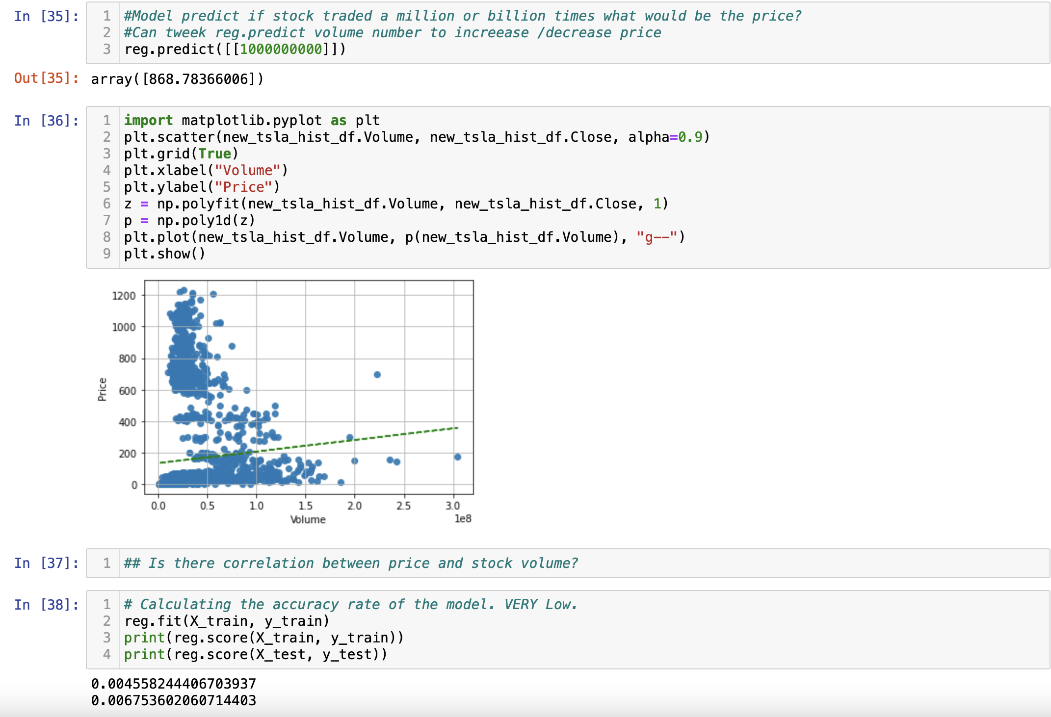
Model Analysis
Step 3 Predict future share price based on trading volume
* There is a correlation between price and volume but accuracy rate is very low.

Slide 9
Results
If Polestar would like to be at the same level as Telsa, they would need to add additional businesses and marketing like Tesla who has tremendous brand recognition in the industry. However, if they would like to stick with EV vehicles only, like the other EV companies, they have a good chance at share prices rising to the same level as your average EV company. Of course, other considerations would need to be made.

Slide 10
Dashboard
EV & Future Transporta-- tion Model – 1 Month
NASDAQ
Placeholder for stock ticker tape
Chart from Data Analysis
Data Analysis Info

Slide 11
Recommendations

Slide 12
What the team would have done differently

Slide 13
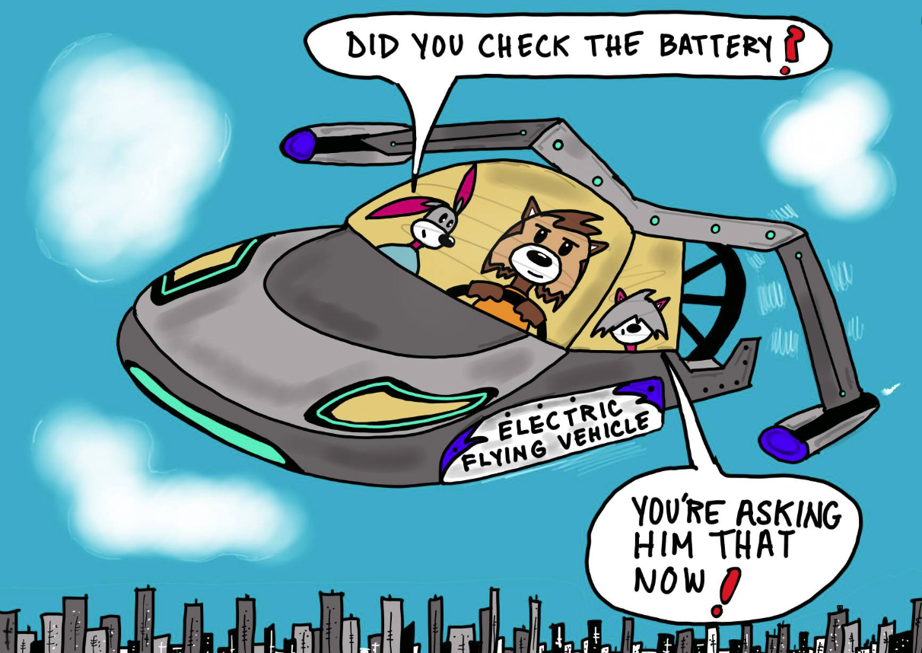

Slide 14
